Slide 1
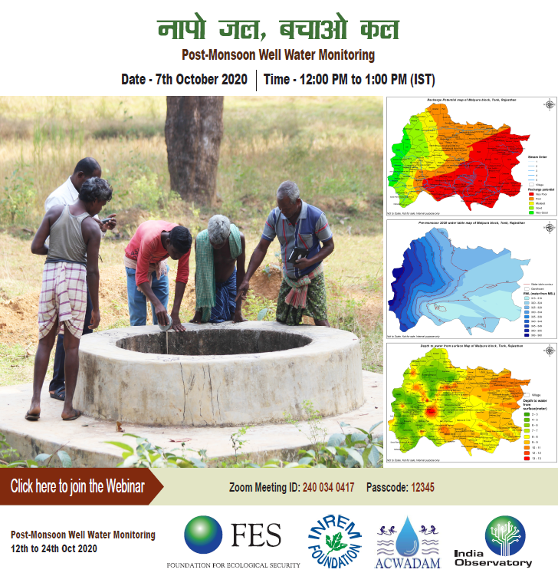

Slide 2
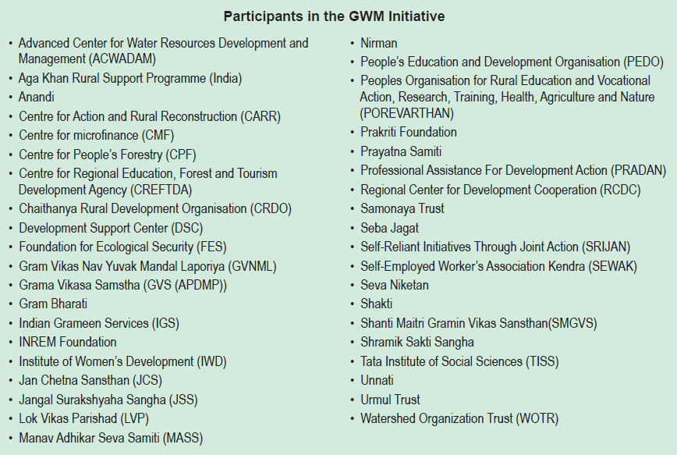
A collaborative initiative during pre-monsoon 2020

Slide 3
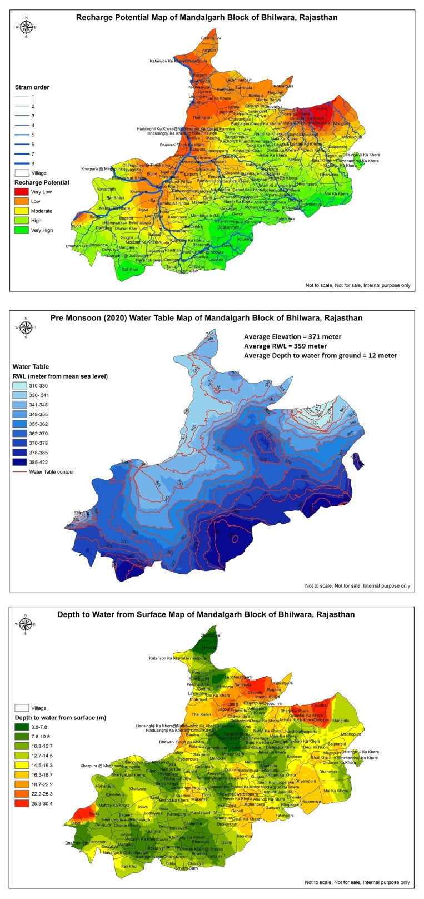
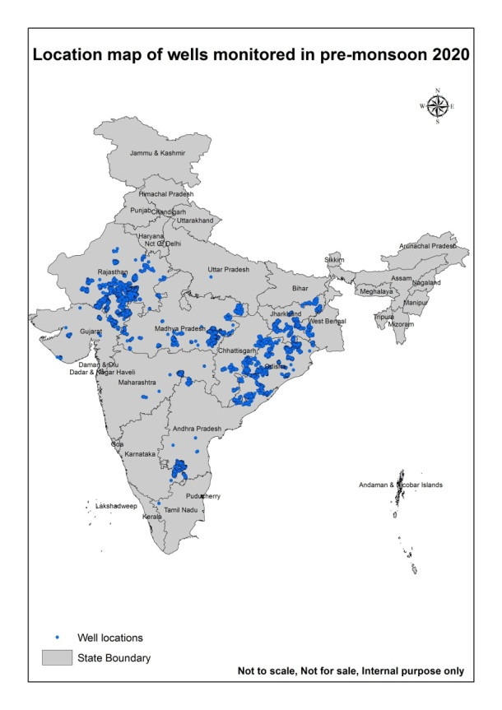
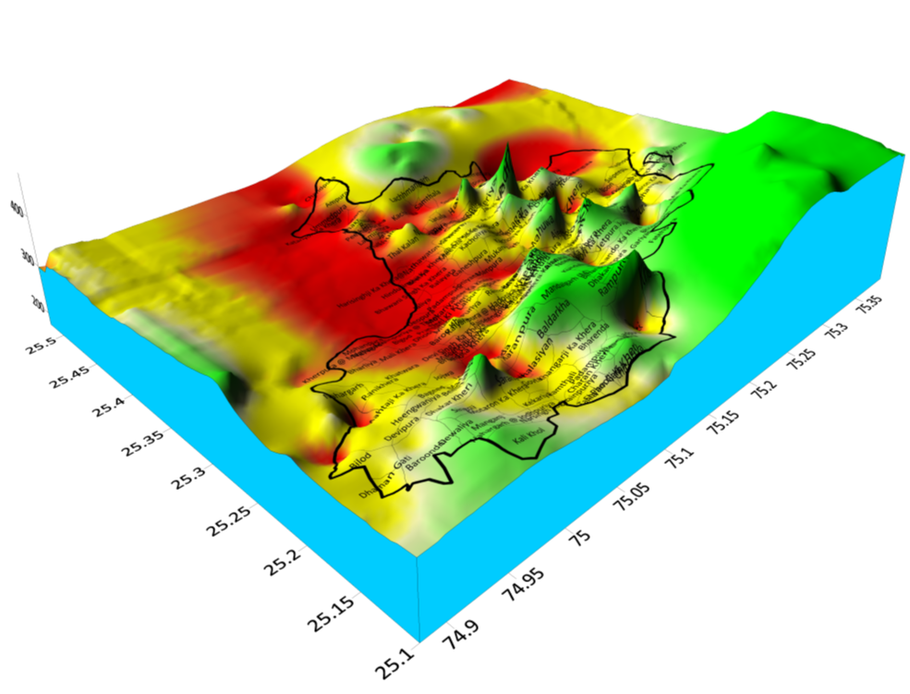
We 40 organizations together collected pre monsoon 2020 water level (12 states, 330 blocks and 17200+ wells)
https://wmt.indiaobservatory.org.in
Outcomes:
Captured local variation of water level
Higher granularity in data
Identified local Recharge and Discharge zone
Identified ground water flow path and contour
Depth to water from surface to access water
Higher accuracy in DST for soil and water conservation

Slide 4
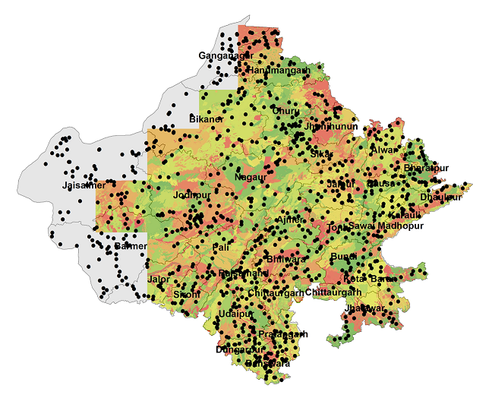
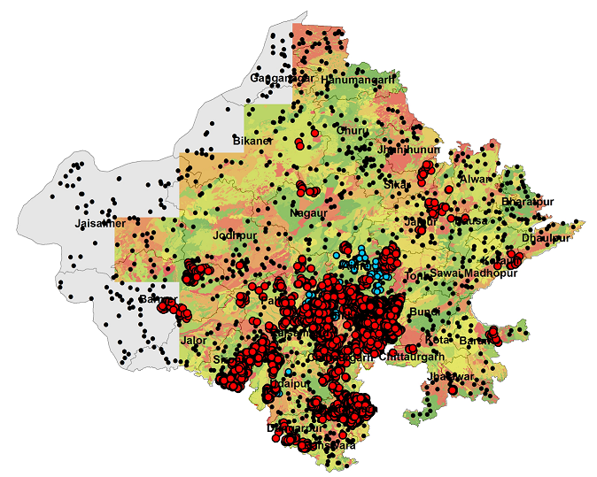
One example: Comparison of Ground Water Data in Rajasthan (CGWB and WMT data)
Water Monitoring Tool Data, 2020 Pre Monsoon
District | Geographic Area (sqkm) | No of Wells | Area (sqkm)/Well
Bhilwara | 10509 | 2098 | 5.0
Chittaurgarh | 7822 | 581 | 13.5
Udaipur | 11724 | 524 | 22.4
Pratapgarh | 4117 | 1325 | 3.1
Sirohi | 5136 | 301 | 17.1
Ajmer | 8481 | 59 | 143.7
Barmer | 28387 | 127 | 223.5
Rajsamand | 4551 | 231 | 19.7
Tonk | 7194 | 106 | 67.9
Dungarpur | 3770 | 86 | 43.8
Pali | 12387 | 405 | 30.6
Jaipur | 11152 | 71 | 157.1
Average Area (sqkm)/Well |  |  | 62.3
CGWB (2007-17)= 1049 wells (326sqkm/well)
Well Monitoring Tool 2020 = 6014 wells (12 districts)

Slide 5
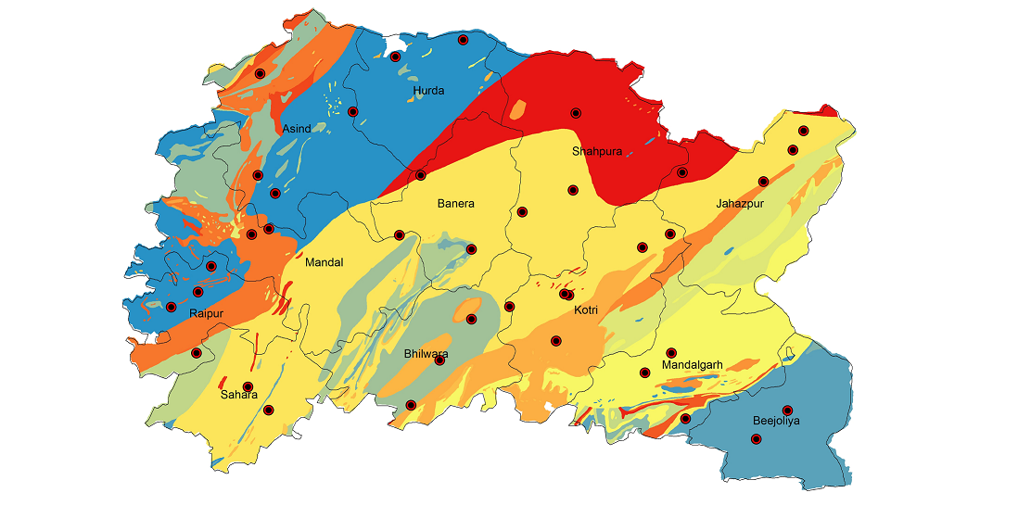
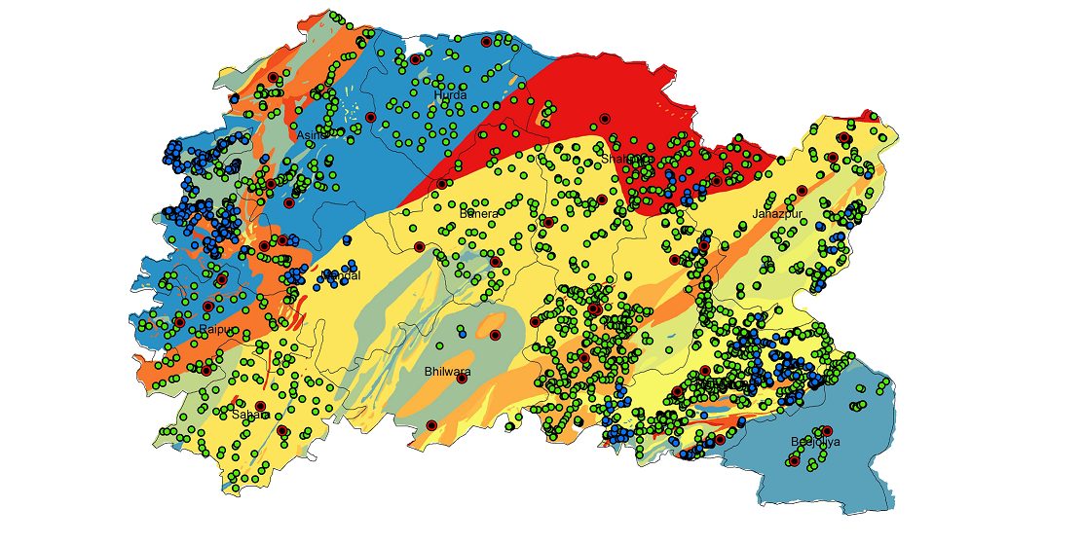
Zoom to Ground Water Data in Bhilwara district of Rajasthan
CGWB = 38 wells (276 sqkm/well)
Well Monitoring Tool = 2090 wells (5.02 sqkm/well)

Slide 6
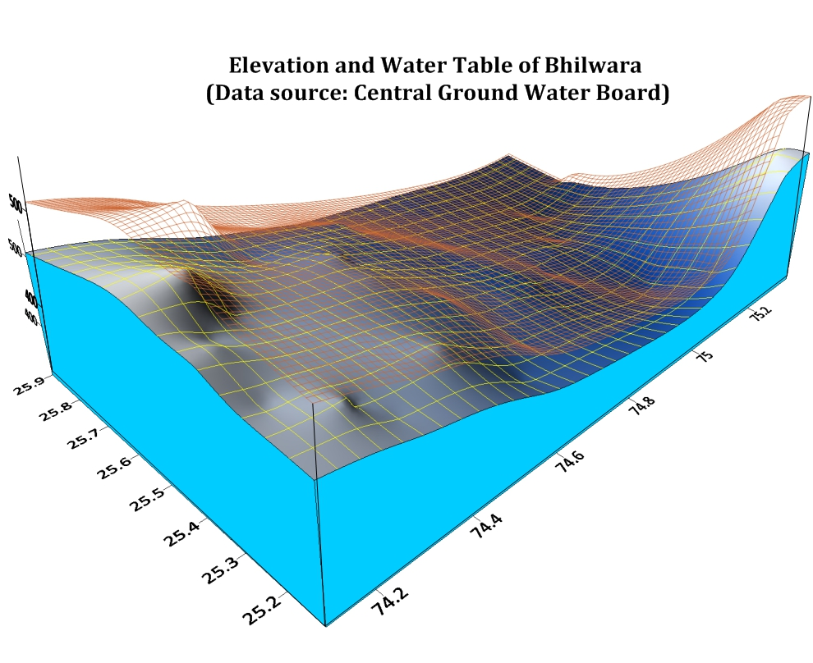
Bijoliya
Jahazpur
Shahpura
Asind
Hurda
518
Elevation wireframe
Mandalgarh
Banera
Kotri
Mandal
Bhilwara
Raipur
Sahara
Water Table

Slide 7
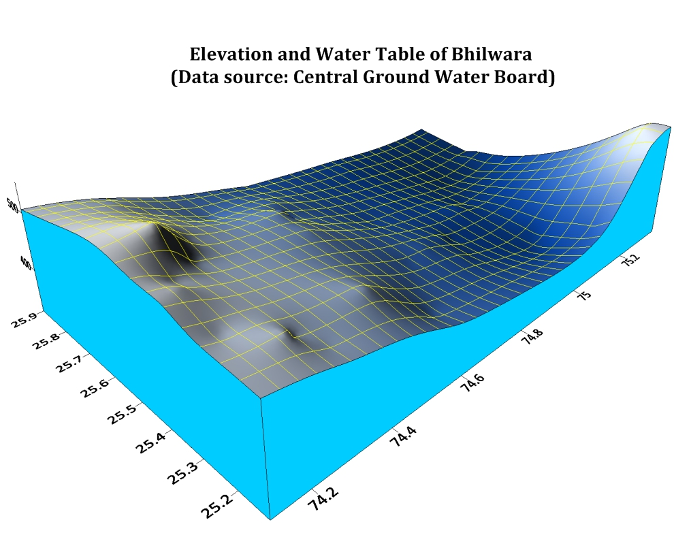
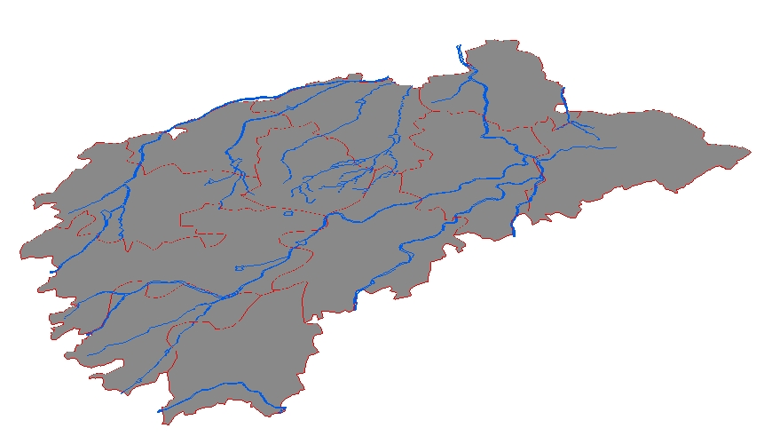
Good Recharge Zone
Moderate Recharge Zone
Bijoliya
Jahazpur
Discharge Zone
Shahpura
Hurda
Asind
Banera
Kotri
Mandalgarh
Mandal
Bhilwara
Raipur
Sahara
Water Table
Drainage System in Bhilwara
N
Ground Water flow path

Slide 8
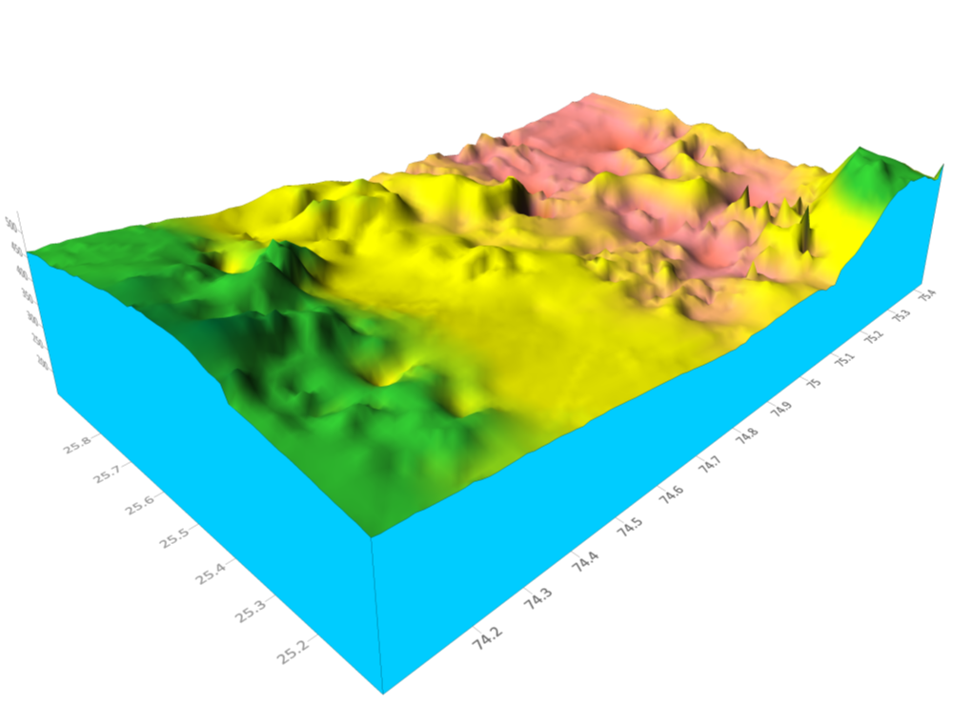
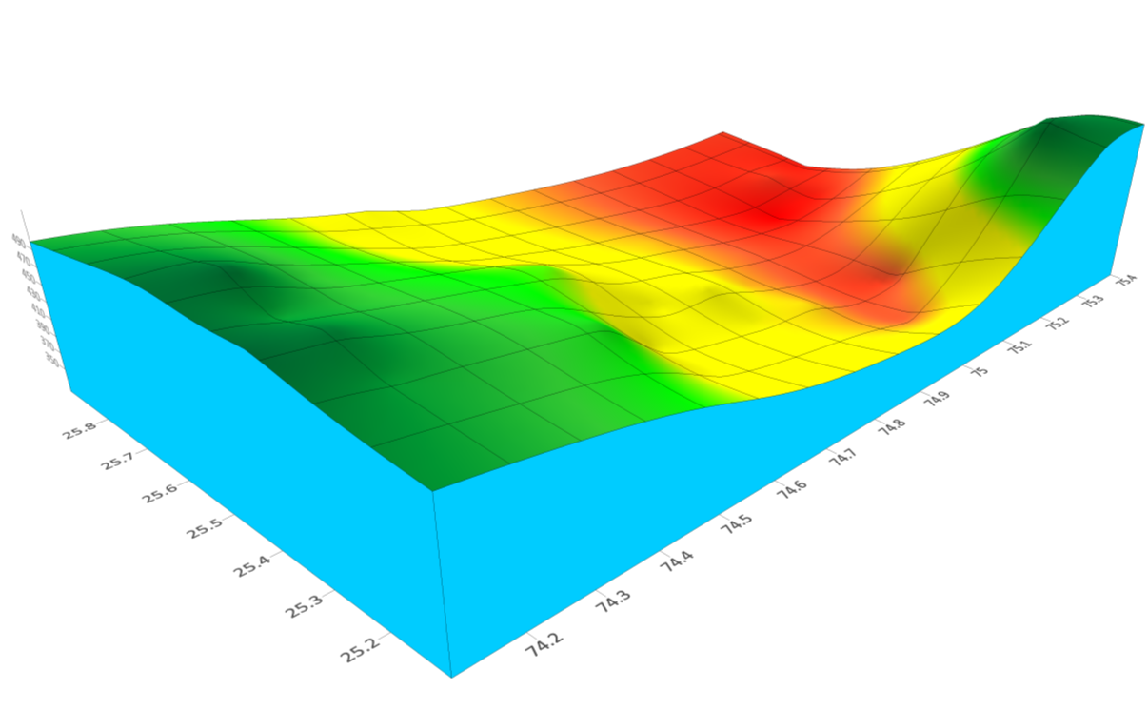

Ground water flow and Recharge potential based on WMT data
Recharge potential map based on CGWB data
Jahazpur
Bijoliya
Shahpura
Hurda
Asind
Banera
Kotri
Mandalgarh
Mandal
Bhilwara
Raipur
Sahara

Slide 9
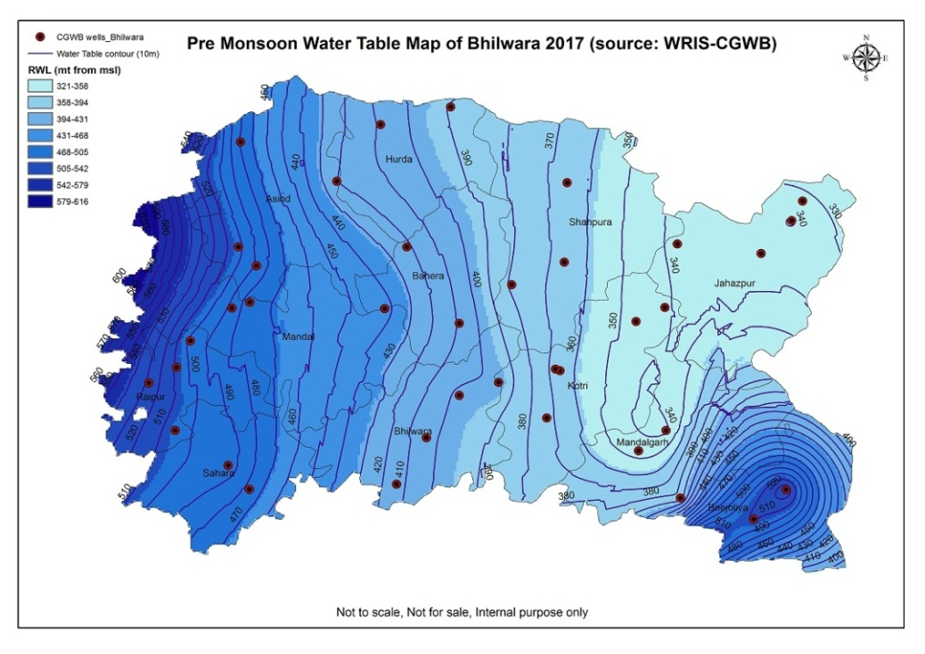
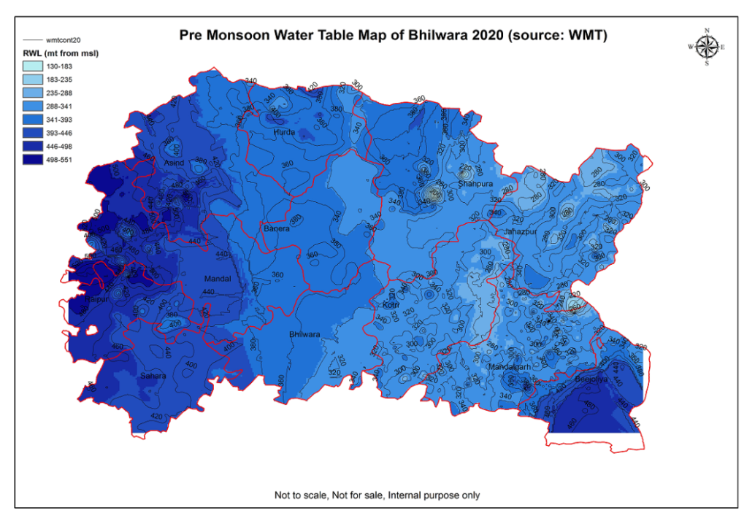
CGWB data wise water table of Bhilwara district
WMT data wise water table of Bhilwara district
WMT data at a higher resolution showing local variation of ground water regime

Slide 10
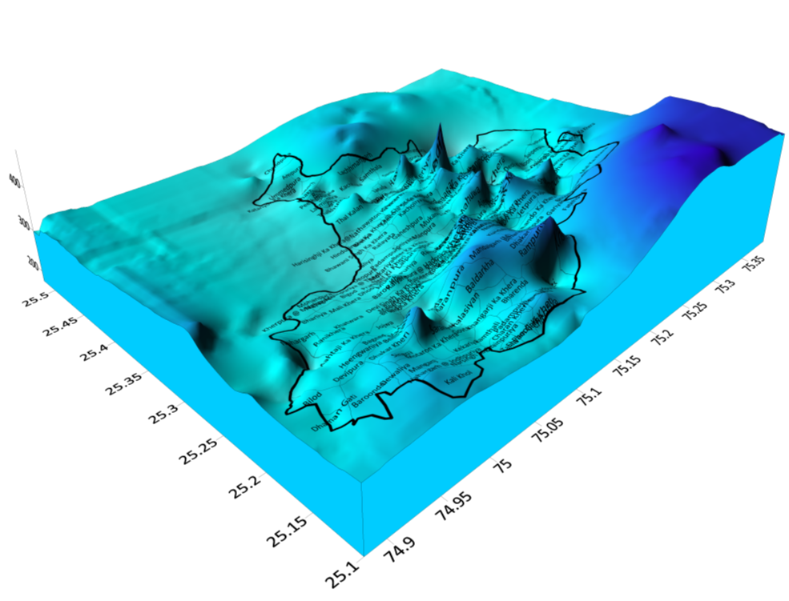
Pre monsoon Ground Water flow of Mandalgarh Block

Slide 11
Recharge potentiality based on Pre monsoon Ground Water flow of Mandalgarh Block

Slide 12
Plan for Post monsoon
Will collect all the wells monitored in pre-monsoon for data consistency
New wells and new locations to increase the coverage
This will provide additional analysis on
  Capturing water level fluctuation
  Rainfall-Recharge correlation
  Accuracy increase of Decision support tool (CLART)
  Help in water budgeting at village
  Water quality assessment (pilot)

Slide 13
Protocols
At least one well per village
If possible choose upto 3 wells far apart from each other in the same village.
We should be able to measure these wells twice a year in the next few years.
If a well is dry, please note the total depth of the well so that we know up to what depth below ground there is no water.
Take the GPS measurement at the ground level and note the depth to water level also from this same point.
Measure water level in meters.
If there is a motor connected to the well, please ensure a minimum of 24 hrs gap between the motor being run and the depth being measured.
If you are equipped and experienced in measuring bore well depths then you are welcome to record depth of bore wells also. Otherwise, you can stick to open wells.
The data collection period is 12th October 2020 to 24th October 2020. In case the rain is ongoing in your location, please collect data 5 days after the rain stop

Slide 14




PROCEDURE OF WELL MEASUREMENT
Do:
1. Put the GPS/Mobile on the ground
2. Measure the depth to water from the ground
Don’t:
Don’t put the Mobile on parapet wall
Don’t measure the depth from parapet wall
MEASURING TAPE
Mobile
Parapet wall
SOIL
DEPTH OF SOIL
ROCK1
DEPTH OF WATER LEVEL
ROCK2
Notes:
14

Slide 15
PROCEDURE OF WELL MEASUREMENT
Do:
1. Put the GPS/Mobile on the ground
2. Measure the depth to water from the ground
Don’t:
Don’t put the Mobile on parapet wall
Don’t measure the depth from parapet wall
MEASURING TAPE
Mobile
SOIL
DEPTH OF SOIL
ROCK1
DEPTH OF WATER LEVEL
ROCK2
Notes:
15

Slide 16
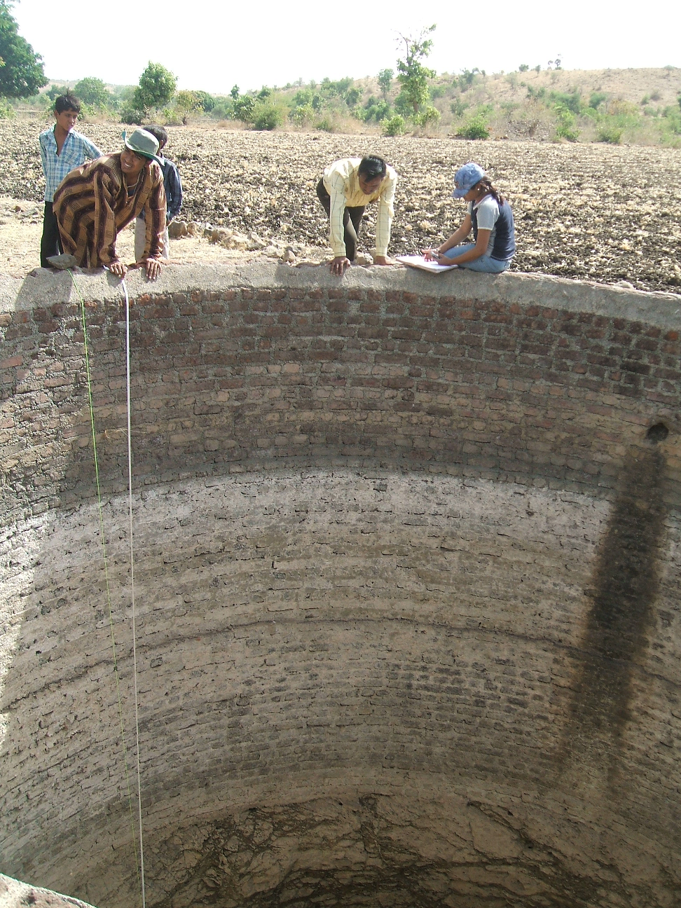
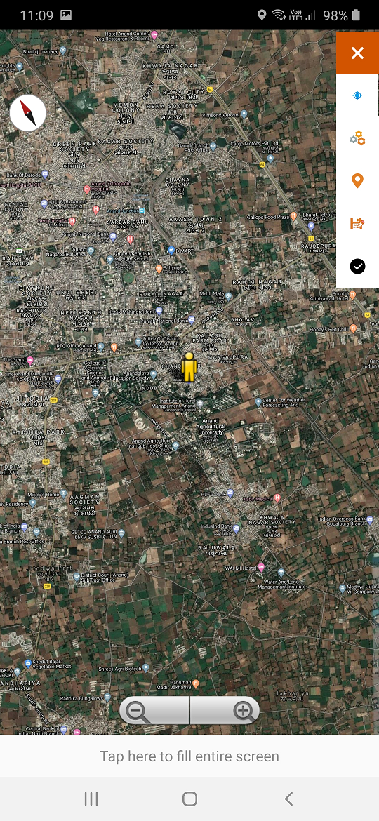
Ground Water Monitoring Tool

Slide 17
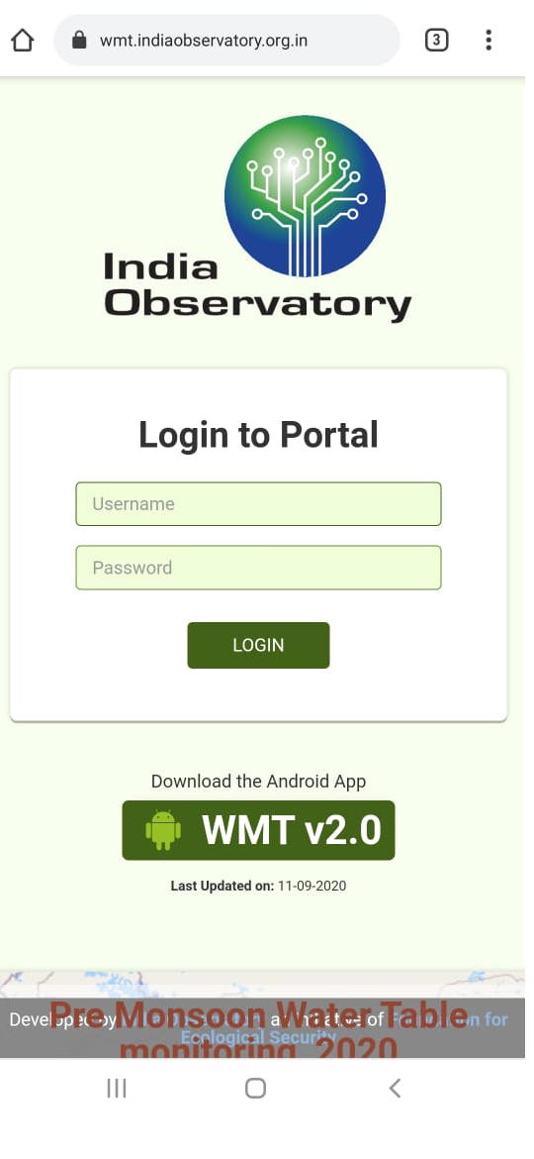
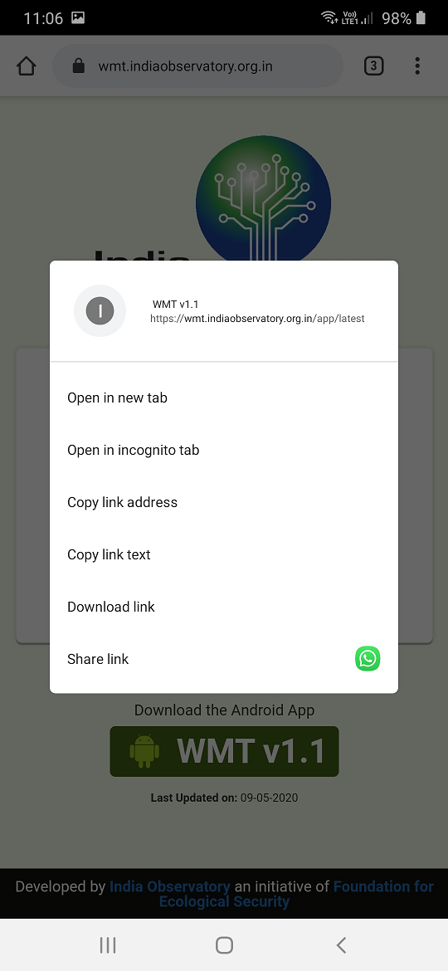
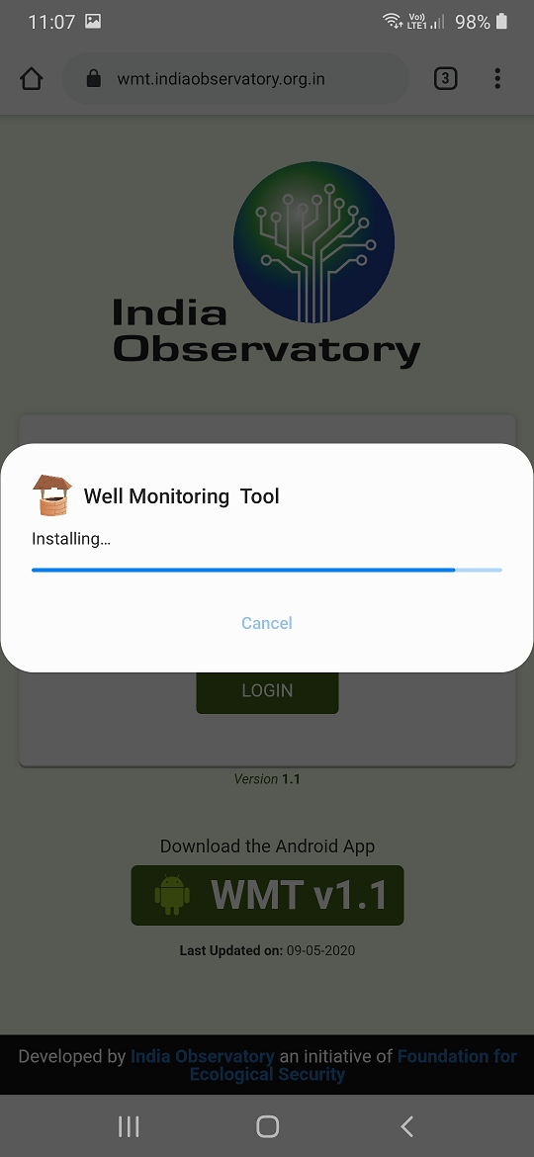
Download the app from https://wmt.indiaobservatory.org.in
Press here to download
Press 3 seconds here to download the app

Slide 18
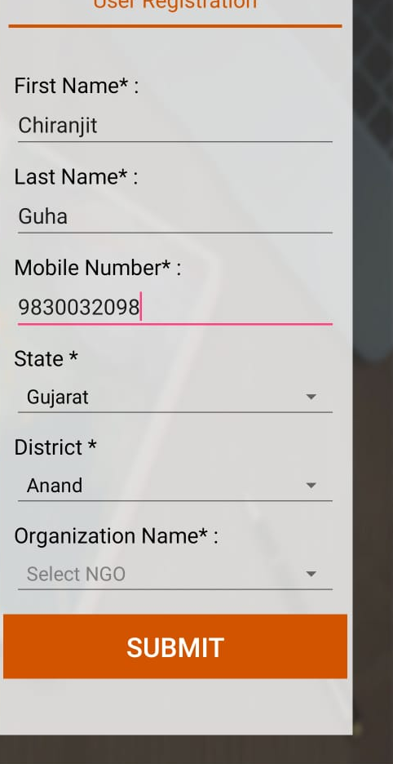
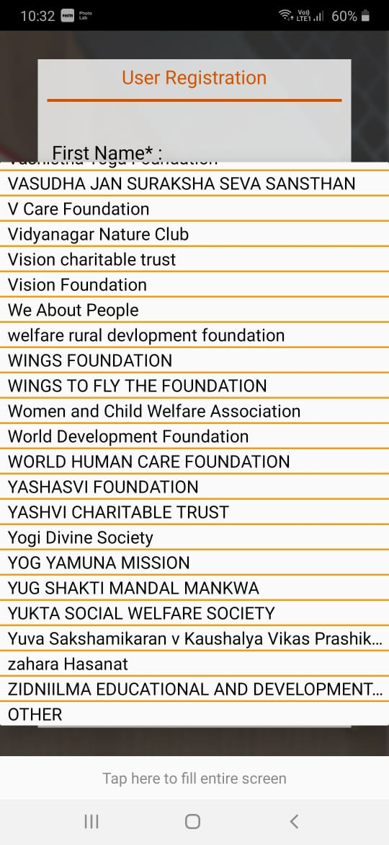
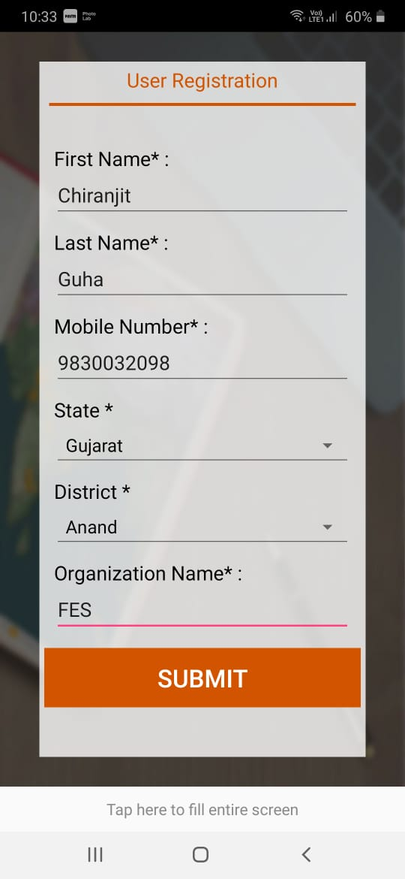
User registration (One time only)
No Internet is required after registration
Once you select the district, you will be able to see the list of organization in that district,
if your organization name is not there, please select other and write the name

Slide 19
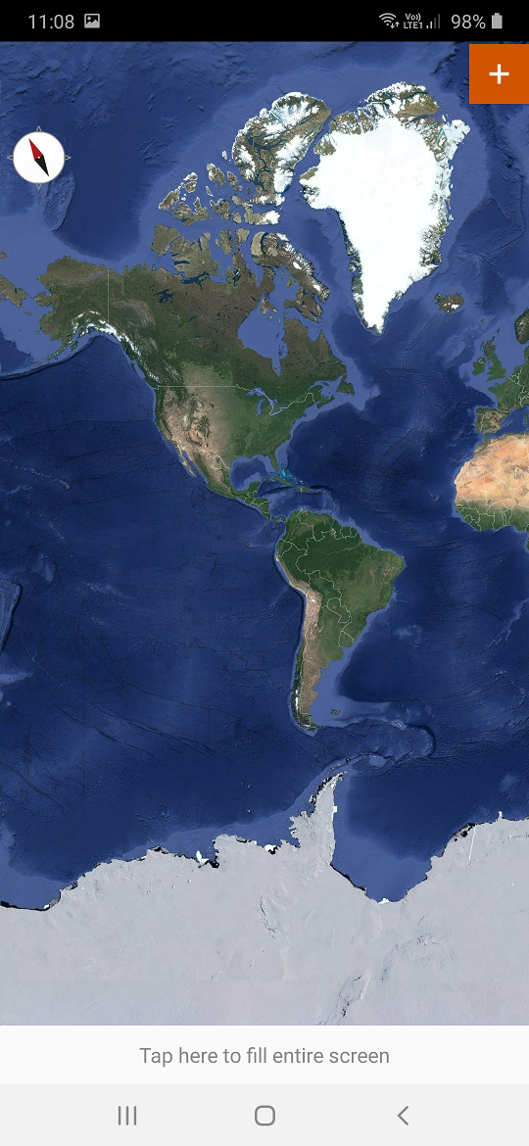
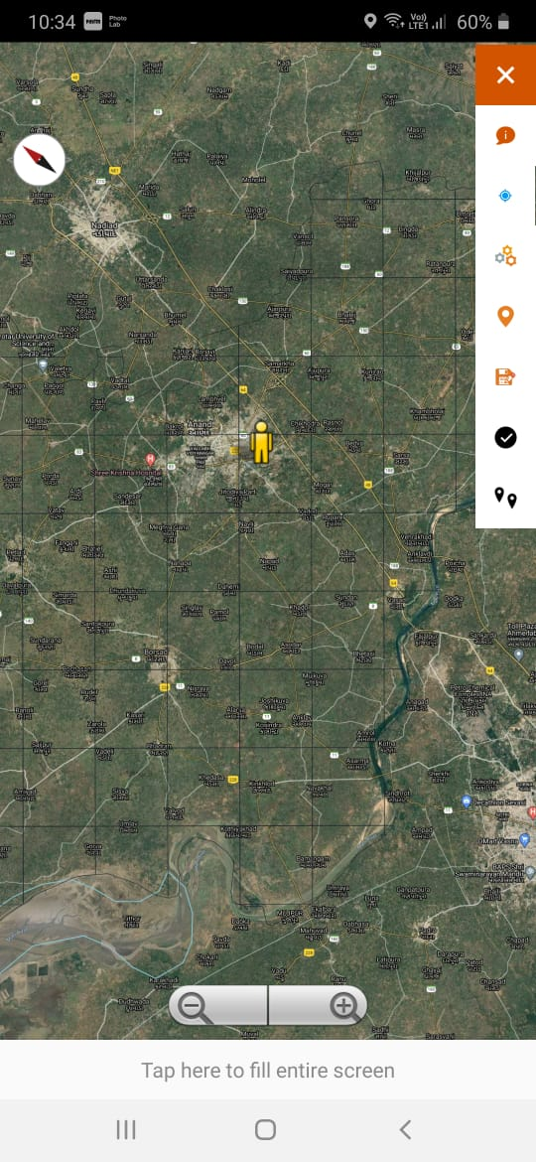
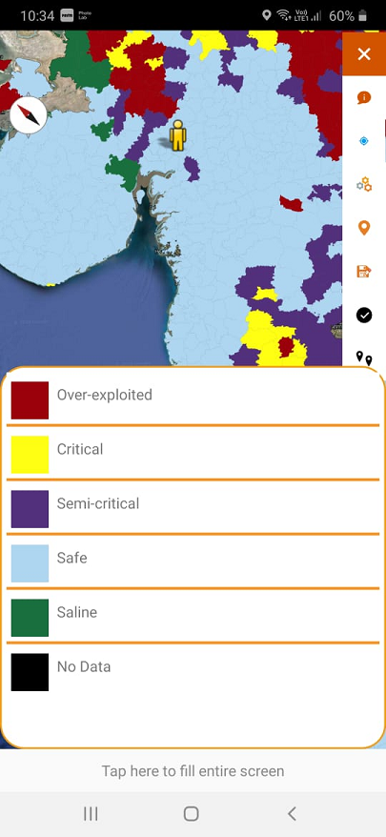
Collection of Data
See the index for your location
(to know the ground water status)
Please zoom out to see the map
Check & enable GPS,
you can see the grid line
Click the + button

Slide 20
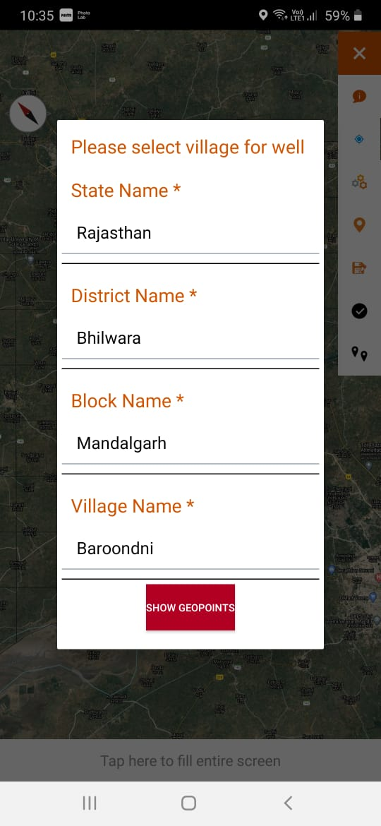
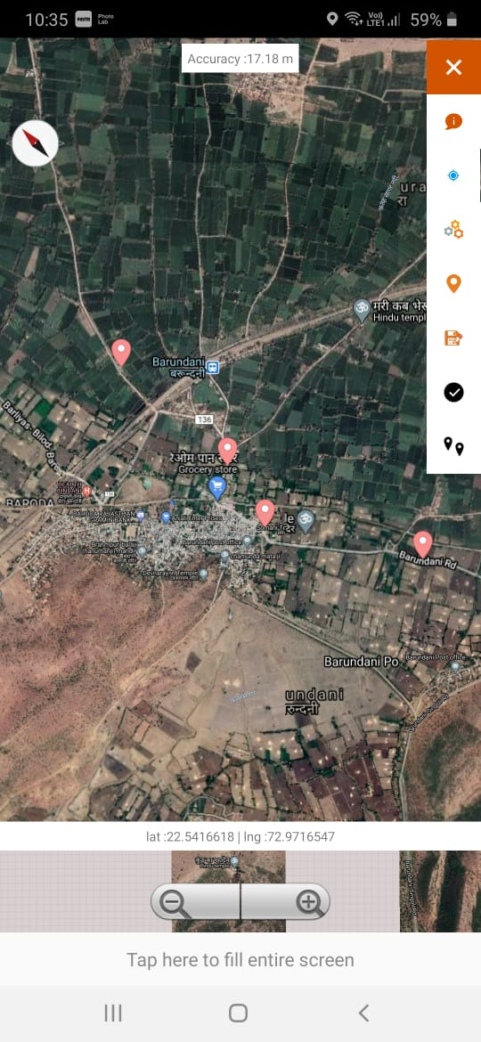
Data collection in the existing well which has been monitored in premonsoon 2020
Click here to select village
Click on the well to see the details

Slide 21
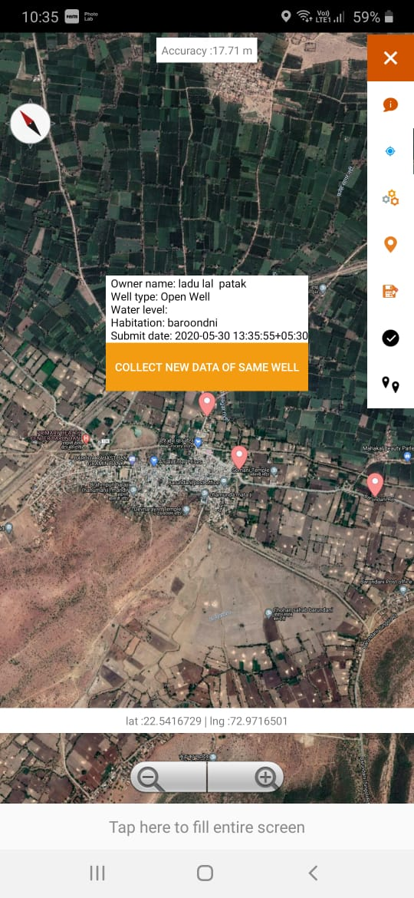
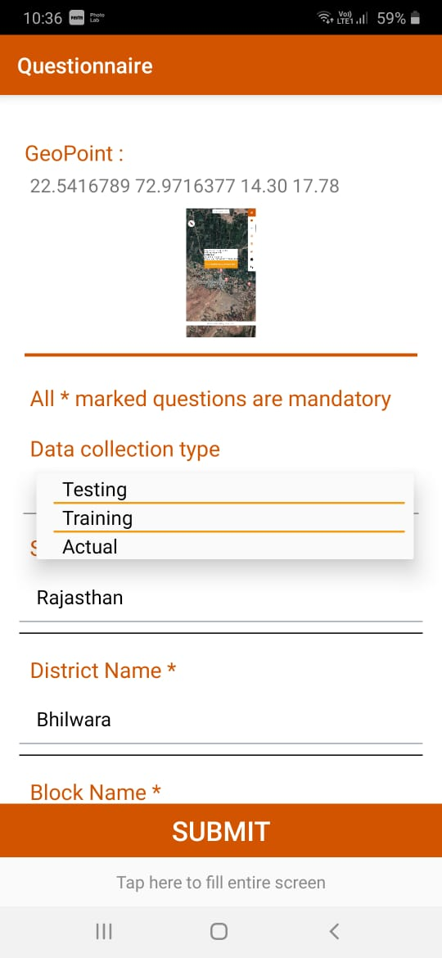
1. If you are taking data from field,
please select “Actual”
2. If it is a training program, please select “Training”
3. If you want to test the tool, please select “Testing”
Click here to enter new water level
in the same well

Slide 22
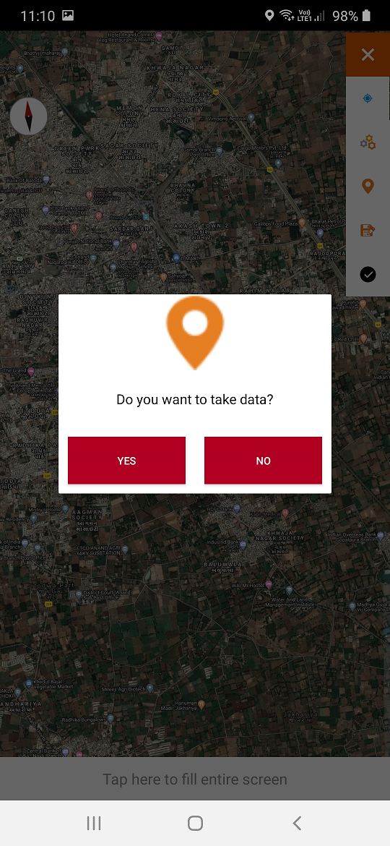
Collection of Data from new well
Click the + button
Check & enable GPS
Take the data

Slide 23
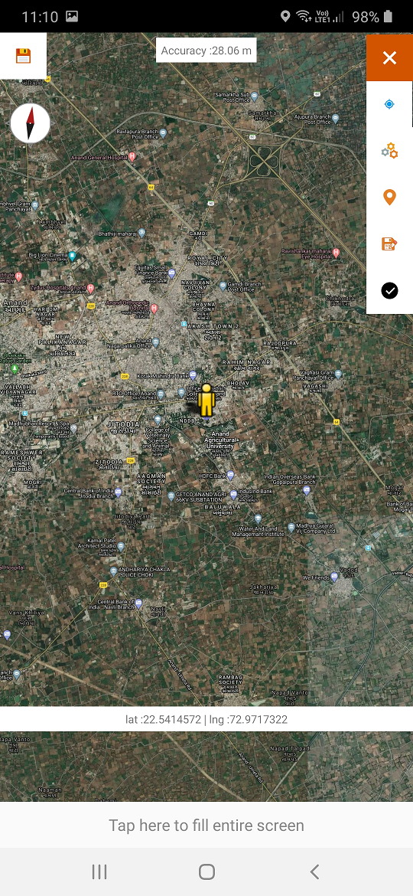
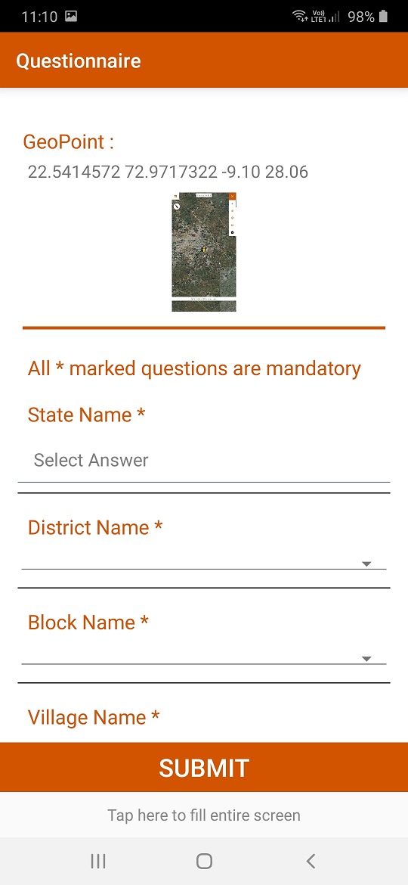
Collection of Data
Click the button to capture screen and location data

Slide 24
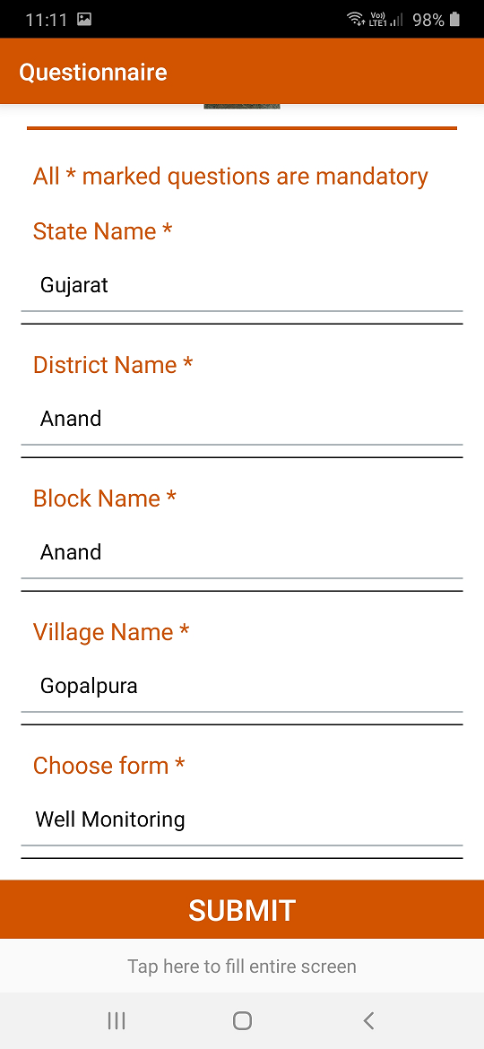
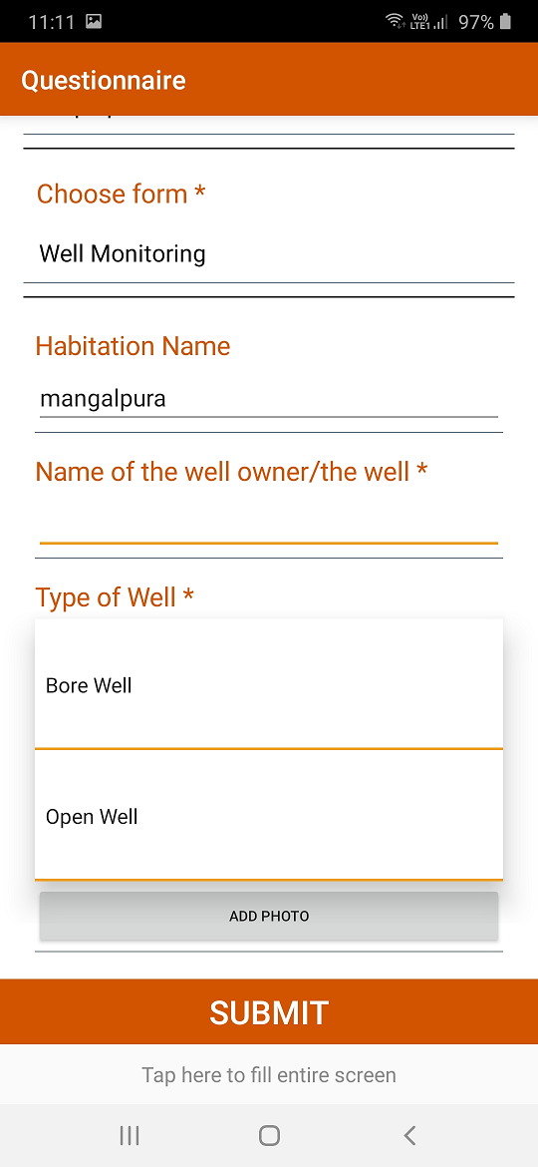
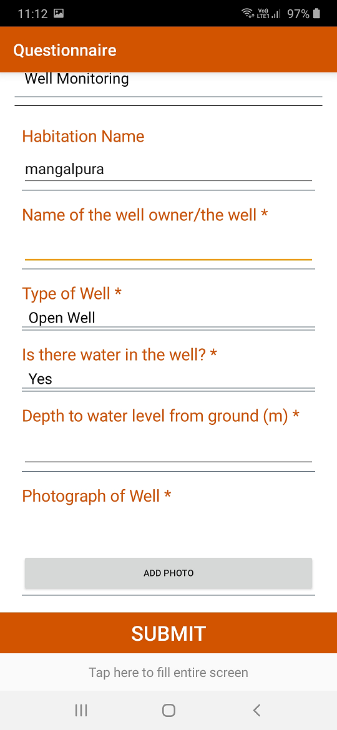
Nos of Questions | Questions | Data input methods
Q1 | Screen capture and Location (Lat/Long/Alt) | Button press
Q2 | State-District-Block-Village | Dropdown
Q3 | Habitation Name | Text
Q4 | Name of the Well owner/well | Text
Q5 | Type of Well (Open/Bore) | Dropdown
Q6 | Does the well have water (Yes/No) | Dropdown
Q7 | If Yes- Depth to water, If No- Well depth | Text
Q8 | Photograph | Button press
Q9 | Water Quality | Dropdown & Text
Collection of Data
Fill up the form

Slide 25
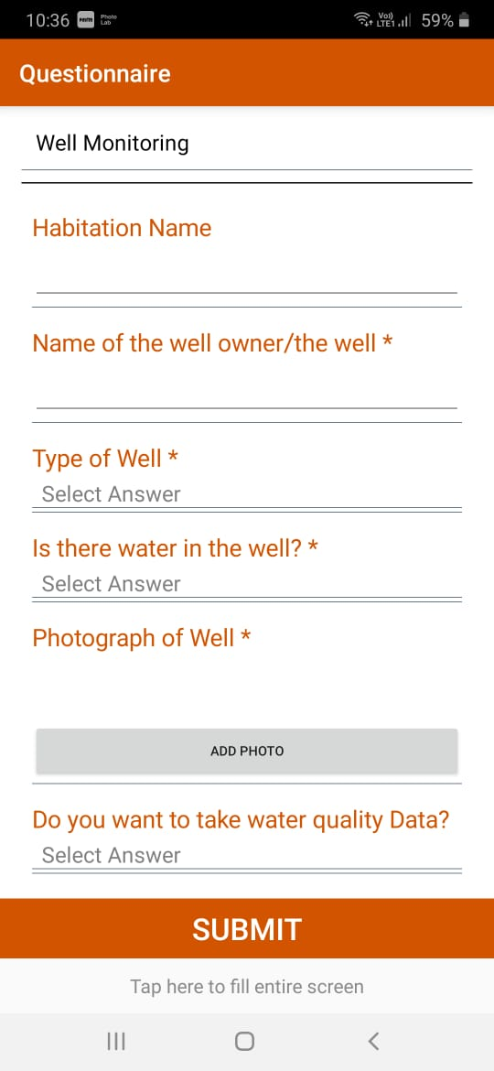
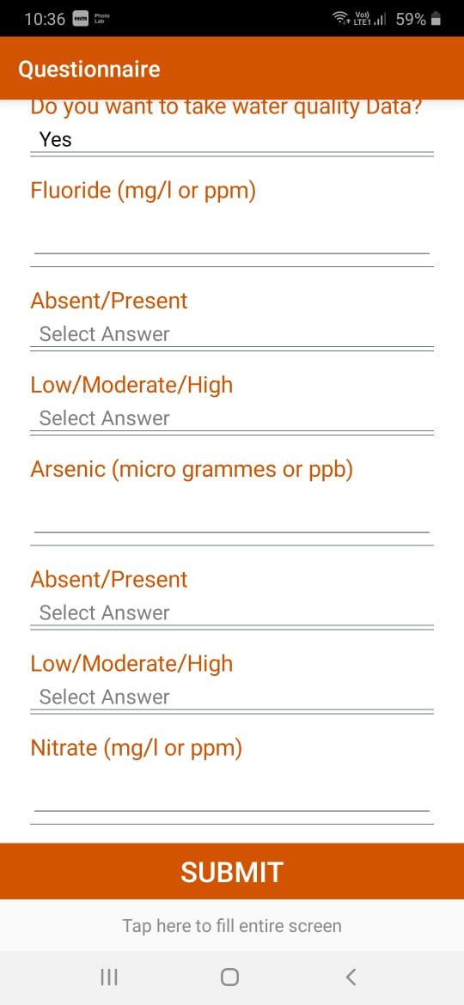
Fill the data
If you want to collect water quality data, please click here

Slide 26
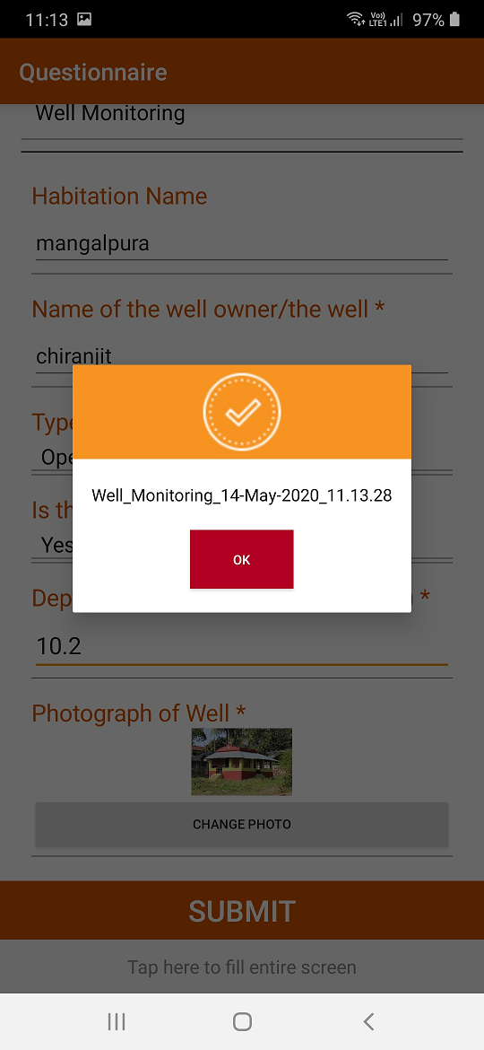
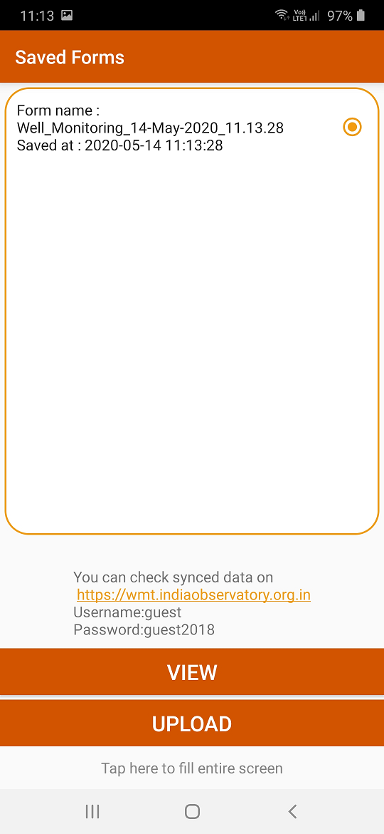
Submit the data
Click submit button to save the data in mobile
Click here to see the saved form
Select and Upload the form

Slide 27
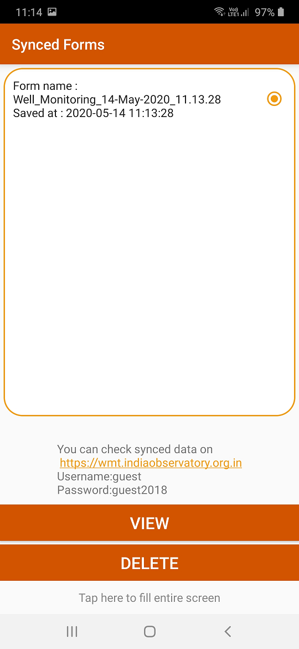
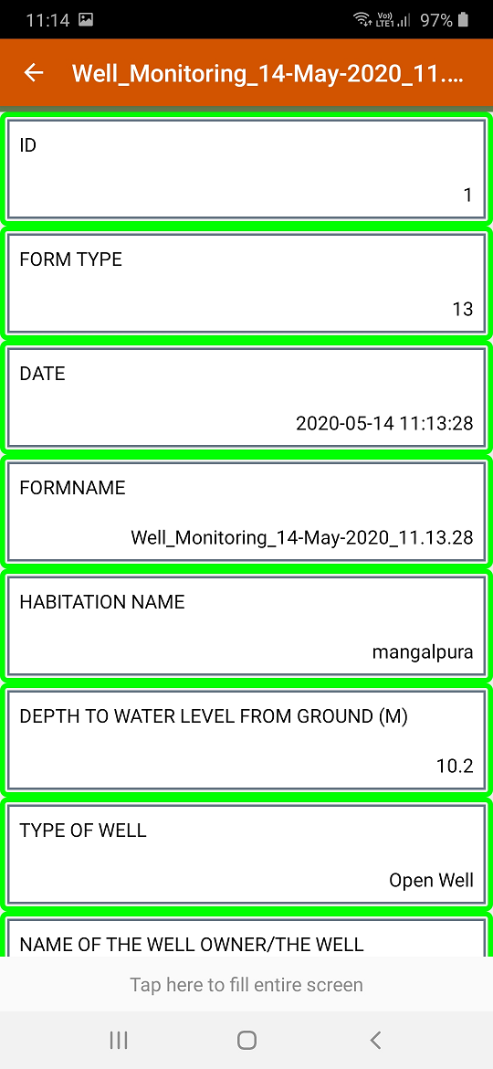
Data visualization after submission in mobile
Click here to see the form after submission also

Slide 28
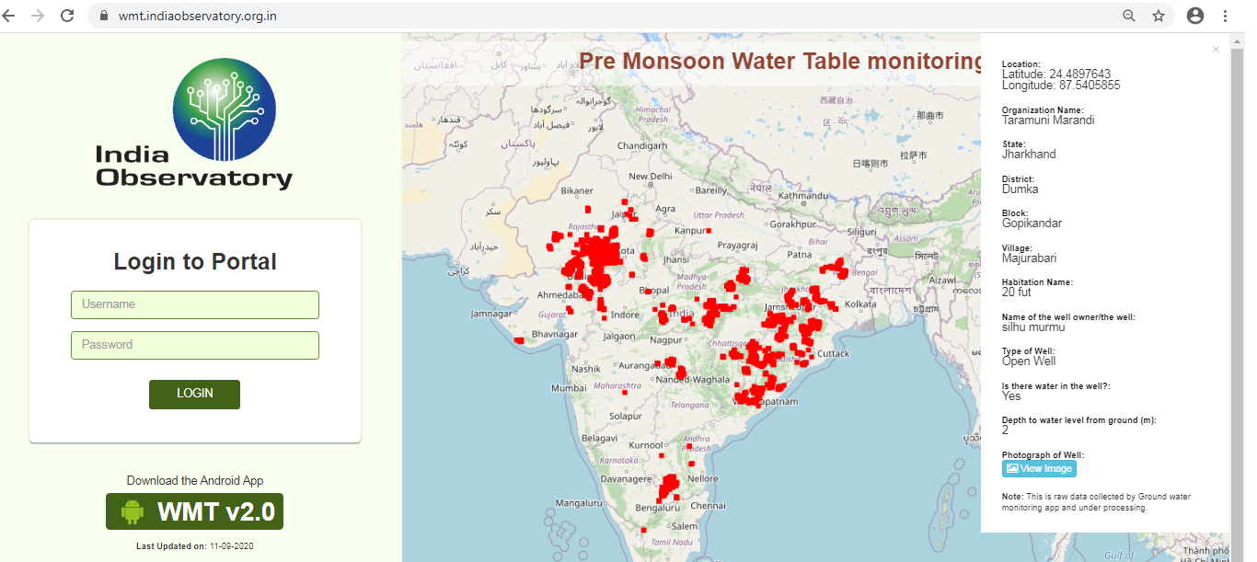
Data visualization after submission in portal
https://wmt.indiaobservatory.org.in
Temporary User id: guest
Password: guest2018

Slide 29
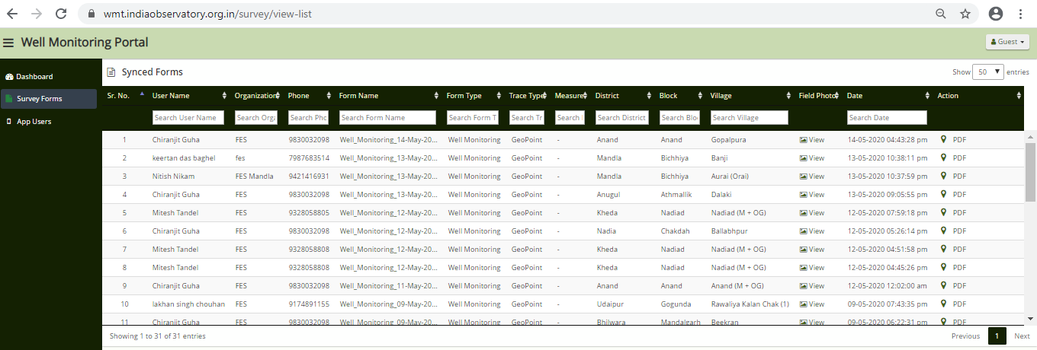
Data visualization after submission in portal
https://wmt.indiaobservatory.org.in
Click here to see the forms
Click here to download data in pdf

Slide 30
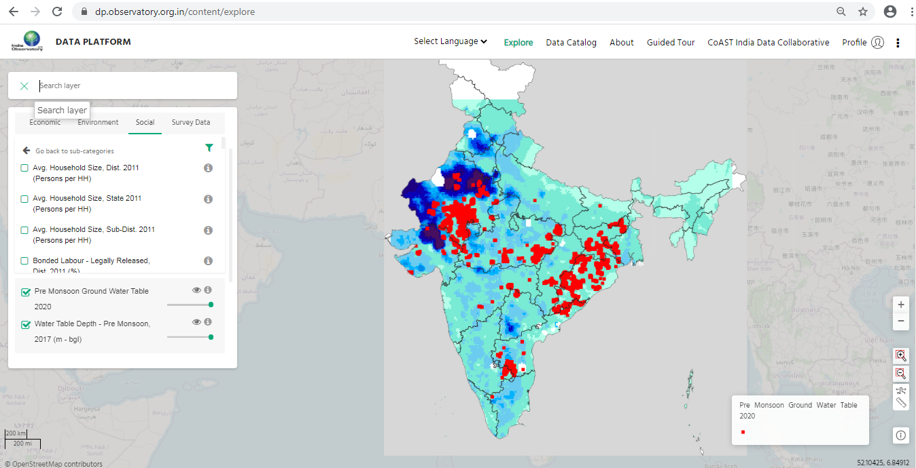
Data is also available in India Observatory Data Platform to correlate
with other 1800+ data layers of India’s Socio-Economic-Environmental parameters
https://dp.observatory.org.in

Slide 31
Thank you
For instructions on how to use the android app and to know more about this initiative kindly refer to the documents in this link - https://www.indiaobservatory.org.in/tool/gmt
To download the app and contribute/visualize the data - register yourself and access the page - https://wmt.indiaobservatory.org.in/.
Write to us: support@indiaobservatory.org.in

